Slide 1
Chapter 10: Functional Dependencies and Normalization for Relational Databases
Presented by
Prof.Dr. Taysir Hassan Abdel Hamid
Information Systems Department
Faculty of Computers and Information
Assiut University
April 10, 2020

Slide 2
Outline
Introduction
Informal Design Guidelines For Relation Schemas
Functional Dependencies
Inference Rules for Functional Dependencies
Normalization of Relations
Steps in Data Normalization
  First Normal Form
  Second Normal Form
  Third Normal Form
Advantages of Normalization
Disadvantages of Normalization
Conclusion
Chapter 10: Functional Dependencies and Normalization for Relational Databases
1

Slide 3
Introduction
Relational database design: is the grouping of attributes to form
“good” relation schemas.
There are two levels of relation schemas:
  The logical “ user view” level.
  The storage “base relation” level
Design is concerned mainly with base relations.
What are the criteria for “good” base relations?
Chapter 10: Functional Dependencies and Normalization for Relational Databases
2

Slide 4
Informal Design Guidelines For Relation Schemas:
Four informal measures:
Semantics of the attributes
Reducing the redundant information in tuples
Reducing the NULL values in tuples
Disallowing the possibility of generating spurious tuples

Slide 5
Informal Design Guidelines For Relation Schemas
1. Semantics of the Relation Attributes
Whenever attributes are grouped to form a relation schema, it is
assumed that attributes belonging to one relation have certain
real-world meaning and a proper interpretation associated with them.
In general the easier it is to explain the semantics of the relation, the
better the relation schema design will be.
Guideline 1: Design a relation schema so that it is easy to explain
its meaning. Do not combine attributes from multiple entity types
and relationship types into a single relation.
Chapter 10: Functional Dependencies and Normalization for Relational Databases
3

Slide 6
Informal Design Guidelines For Relation Schemas
2. Redundant Information in Tuples and Update Anomalies
One goal of schema design is to minimize the storage space used by
the base relations.
Grouping attributes into relation schemas has a significant effect on
storage space.
Mixing attributes of multiple entities may cause problems
Information is stored redundantly wasting storage.
Chapter 10: Functional Dependencies and Normalization for Relational Databases
4

Slide 7
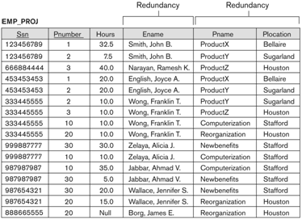
Informal Design Guidelines For Relation Schemas
2. Redundant Information in Tuples and Update Anomalies
Chapter 10: Functional Dependencies and Normalization for Relational Databases
5

Slide 8
Informal Design Guidelines For Relation Schemas
2. Redundant Information in Tuples and Update Anomalies
A serious problem is the problem of update anomalies.
Update anomalies:
  Insertion anomalies.
  Deletion anomalies.
  Modification anomalies.
Chapter 10: Functional Dependencies and Normalization for Relational Databases
7

Slide 9
Informal Design Guidelines For Relation Schemas
2. Redundant Information in Tuples and Update Anomalies
EMP_PROJ
Insertion Anomalies:
  Occurs when it is impossible to store a fact until another fact is
  known.
  Example:
    Cannot insert a project unless an employee is assigned to.
    Cannot insert an employee unless he/she is assigned to a
    project.
SSN
PNumber
Hours
EName
PName
PLocation
Chapter 10: Functional Dependencies and Normalization for Relational Databases
8

Slide 10
Informal Design Guidelines For Relation Schemas
2. Redundant Information in Tuples and Update Anomalies
EMP_PROJ
Delete anomalies:
  Occurs when the deletion of a fact causes other facts to be
  deleted.
  Example:
    When a project is deleted, it will result in deleting all the
    employees who work on that project.
    If an employee is the sole employee on a project, deleting
    that employee would result in deleting the corresponding
    project.
SSN
PNumber
Hours
EName
PName
PLocation
Chapter 10: Functional Dependencies and Normalization for Relational Databases
9

Slide 11
Informal Design Guidelines For Relation Schemas
2. Redundant Information in Tuples and Update Anomalies
EMP_PROJ
Modification Anomalies:
  Occurs when a change in a fact causes multiple modifications to
  be necessary.
  Example: changing the name of project number P1 (for example)
  may cause this update to be made for all employees working on
  that project.
SSN
PNumber
Hours
EName
PName
PLocation
Chapter 10: Functional Dependencies and Normalization for Relational Databases
10

Slide 12
Informal Design Guidelines For Relation Schemas
2. Redundant Information in Tuples and Update Anomalies
Guideline 2: Design the base relation schemas so that no insertion,
deletion, or modification anomalies are present in the relations.
if any anomalies are present, note them clearly and make sure that
the programs that update the database will operate correctly.
Chapter 10: Functional Dependencies and Normalization for Relational Databases
11

Slide 13
Informal Design Guidelines For Relation Schemas
3. Null Values in Tuples
In some schema designs many attributes may be grouped together
into a “flat” relation.
If many of the attributes do not apply to all tuples in the relation,
many null values will appear in those tuples.
Guideline 3: As far as possible, avoid placing attributes in a base
relation whose values may frequently be null. If nulls are
unavoidable, make sure that they apply in exceptional cases only
and do not apply to a majority of tuples in the relation.
Chapter 10: Functional Dependencies and Normalization for Relational Databases
12

Slide 14
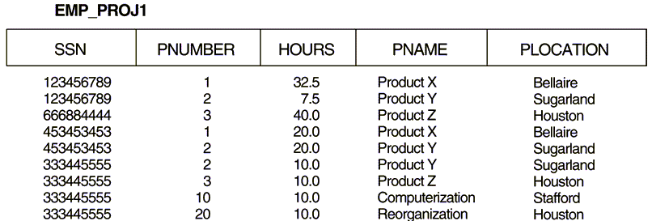
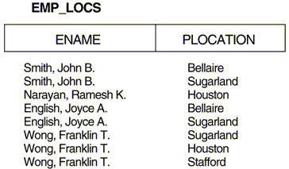
Informal Design Guidelines For Relation Schemas
4. Generation of Spurious Tuples (Additional invalid tuples)
Bad designs for a relational database may result in erroneous results
for certain JOIN operations.
Chapter 10: Functional Dependencies and Normalization for Relational Databases
13

Slide 15
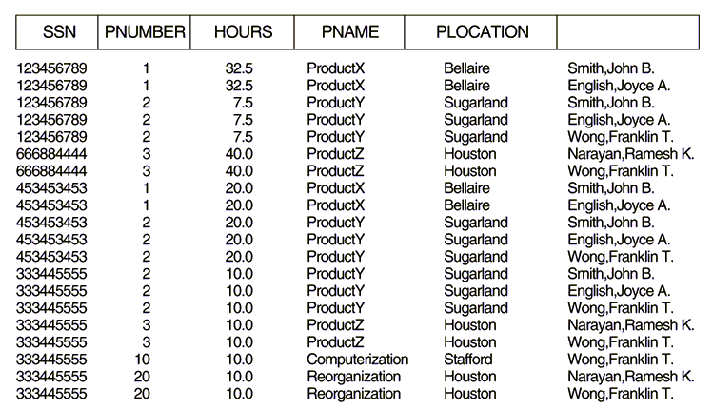
Informal Design Guidelines For Relation Schemas
4. Generation of Spurious Tuples
Additional invalid tuples (called spurious tuples) are present after
applying the natural join.
Spurious tuples
EName
Chapter 10: Functional Dependencies and Normalization for Relational Databases
14

Slide 16
Informal Design Guidelines For Relation Schemas
4. Generation of Spurious Tuples
Guideline 4: Design relation schemas so that they can be joined
with equality conditions on attributes that are either primary keys
or foreign keys in a way that guarantees that no spurious tuples are
generated.
Chapter 10: Functional Dependencies and Normalization for Relational Databases
15

Slide 17
Functional Dependencies
Functional dependencies (FDs) are used to specify formal measures
of the “goodness” of relational designs.
FDs and keys are used to define normal forms for relations.
FDs are constraints that are derived from the meaning and
interrelationships of the data attributes.
A set of attributes X functionally determines a set of attributes Y
if the value of X determines a unique value for Y
Chapter 10: Functional Dependencies and Normalization for Relational Databases
16

Slide 18
Functional Dependencies
X Y holds if whenever two tuples have the same value for X,
they must have the same value for Y
X Y in R specifies a constraint on all relation instances r(R).
Chapter 10: Functional Dependencies and Normalization for Relational Databases
17

Slide 19
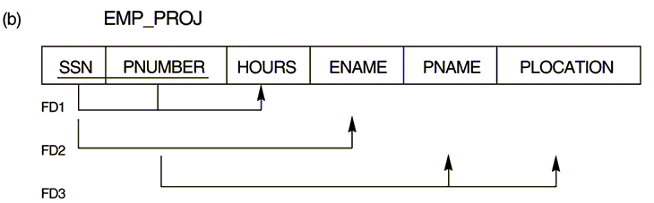
Functional Dependencies
{SSN, PNUMBER} HOURS
SSN ENAME
PNUMBER {PNAME, PLOCATION}
Chapter 10: Functional Dependencies and Normalization for Relational Databases
18

Slide 20
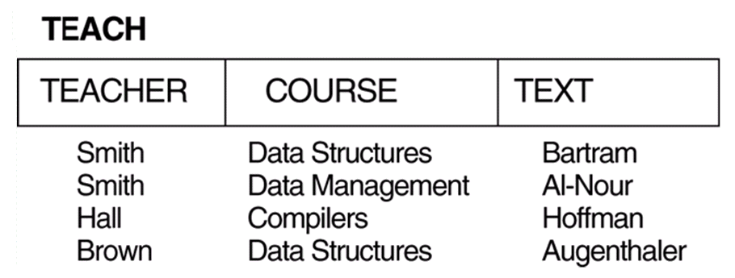
Functional Dependencies
TEXT COURSE
TEACHER COURSE
Chapter 10: Functional Dependencies and Normalization for Relational Databases
19

Slide 21
Inference Rules for Functional Dependencies
Given a set of FDs F, we can infer additional FDs that hold
whenever the FDs in F hold using the following rules:
IR1 (reflexive rule): If X Y, then X Y.
IR2 (augmentation rule): {X Y} then XZ YZ.
IR3 (transitive rule): {X Y, Y Z} then X Z.
IR4 (decomposition, or projective, rule): {X YZ} then X Y.
IR5 (union, or additive, rule): {X Y, X Z} then X YZ.
IR6 (pseudotransitive rule): {X Y, WY Z} then WX Z.
Form a sound and complete set of inference rules.
The set of all dependencies that include F as well as all dependencies
that can be inferred from F is called the closure of F; denoted by F .
+
Chapter 10: Functional Dependencies and Normalization for Relational Databases
20

Slide 22
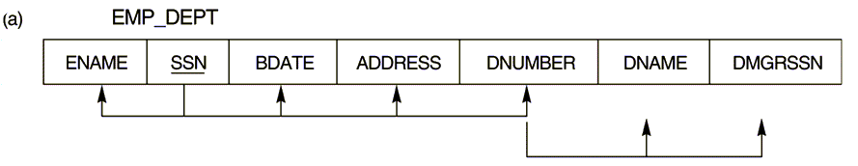
Inference Rules for Functional Dependencies
SSN {ENAME, BDATE, ADDRESS, DNUMBER}
DNUMBER {DNAME, DMGRSSN}
Some additional functional dependencies that we can infer are:
SSN {DNAME, DMGRSSN}
DNUMBER DNAME
Chapter 10: Functional Dependencies and Normalization for Relational Databases
21

Slide 23
Normalization of Relations
Normalization is the process of decomposing relations with
anomalies to produce smaller, well structured relations.
Normalization can be accomplished and understood in stages, each
of which corresponds to a normal form.
Normal form is a state of a relation that results from applying
simple rules regarding functional dependencies (or relationships
between attributes) to that relation.
Chapter 10: Functional Dependencies and Normalization for Relational Databases
22

Slide 24
Normalization of Relations
Normal forms:
  First Normal Form (1NF).
  Second Normal Form (2NF).
  Third Normal Form (3NF).
  Boyce-Codd Normal Form (BCNF).
  Fourth Normal Form (4NF).
  Fifth Normal Form (5NF).
Database design as practiced in industry today pays particular
attention to normalization only up to 3NF, BCNF, or 4NF.
The database designers need not normalize to the highest possible
normal form.
A stronger definition of 3NF
Chapter 10: Functional Dependencies and Normalization for Relational Databases
23

Slide 25
Steps in Data Normalization
UNORMALISED ENTITY
Step 1: remove repeating groups
1st NORMAL FORM
Step 2: remove partial dependencies
2nd NORMAL FORM
Step 3: remove indirect dependencies
3rd NORMAL FORM
Step 4: remove multi-dependencies
Step 4: every determinate a key
4th NORMAL FORM
BOYCE-CODD NORMAL FORM
Chapter 10: Functional Dependencies and Normalization for Relational Databases
25

Slide 26
Steps in Data Normalization
1. First Normal Form
1NF is now considered to be part of the formal definition of a
relation in the basic (flat) relational model.
It was defined to disallow multivalued attributes, composite
attributes, and their combinations. (I.e. The only attribute values permitted by 1NF are single atomic values).
Chapter 10: Functional Dependencies and Normalization for Relational Databases
26

Slide 27
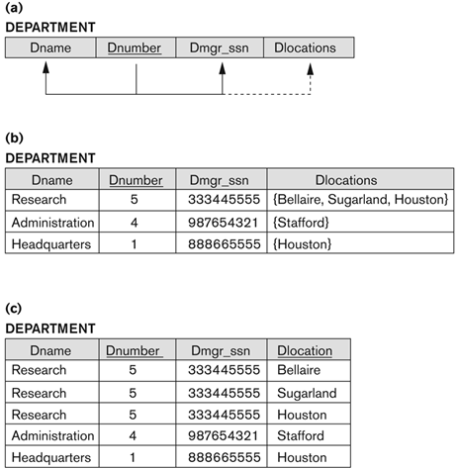
Steps in Data Normalization
1. First Normal Form
There are two ways we can look at Dlocations attribute:
* The Domain of Dlocations contains atomic values, but some tuples can have a set of these values. In this case, Dlocations is not functionally dependent on the primary key Dnumber
Chapter 10: Functional Dependencies and Normalization for Relational Databases
27

Slide 28
Steps in Data Normalization (Cont…)
1. First Normal Form
The other way we can look at Dlocations attribute:
* The domain of Dlocations contains sets of values and hence is nonatomic. In this case, Dnumber → Dlocations because each set is considered a single member of the attribute domain.

Slide 29
Steps in Data Normalization
1. First Normal Form
There are three main techniques to achieve first normal form for
such a relation:
  Remove the attribute DLOCATIONS that violates 1NF and
  place it in a separate relation DEPT_LOCATIONS along with
  the primary key DNUMBER of DEPARTMENT.
  Expand the key so that there will be a separate tuple in the
  original DEPARTMENT relation for each location of a
  DEPARTMENT.
  If a maximum number of values is known for the attribute (e.g. 3)
  replace the DLOCATIONS attribute by three atomic attributes:
  DLOCATION1, DLOCATION2, DLOCATION3.
Redundancy
Null values
Chapter 10: Functional Dependencies and Normalization for Relational Databases
28

Slide 30

Steps in Data Normalization
1. First Normal Form
Chapter 10: Functional Dependencies and Normalization for Relational Databases
29

Slide 31
Steps in Data Normalization
2. Second Normal Form
A relation is in 2NF if it is in 1NF and every nonprime attribute is fully functionally dependent on the primary key.
I.e. remove any attributes which are dependent on part of the
compound key.
These attributes are put into a separate table along with that part of
the compound key.
Not a member of
any candidate key
Chapter 10: Functional Dependencies and Normalization for Relational Databases
30

Slide 32
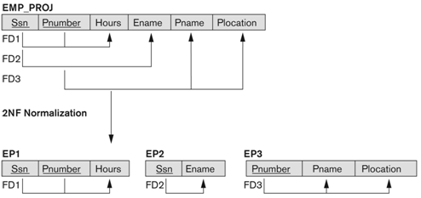
Steps in Data Normalization
2. Second Normal Form
Chapter 10: Functional Dependencies and Normalization for Relational Databases
31

Slide 33
Steps in Data Normalization
3. Third Normal Form
A relation is in 3NF if it is in 2NF and no nonprime attribute A in R is transitively dependent on the primary key.
I.e. Separate attributes which are dependent on another attribute
other than the primary key within the table.
Chapter 10: Functional Dependencies and Normalization for Relational Databases
32

Slide 34
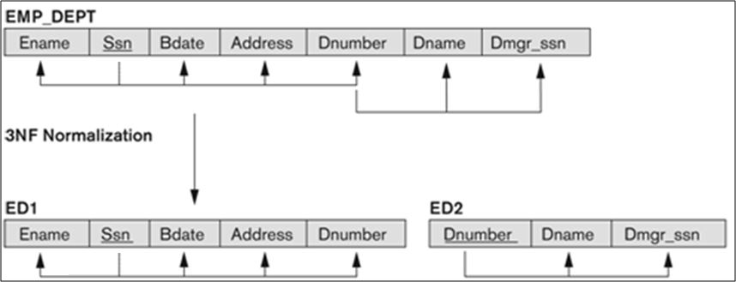
Steps in Data Normalization
3. Third Normal Form
Chapter 10: Functional Dependencies and Normalization for Relational Databases
33

Slide 35
General Definitions of Second and Third Normal Forms
The following more general definitions take into account relations
with multiple candidate keys.
A relation is in 2NF if it is in 1NF and every nonprime attribute is
fully functionally dependent on every key.
A relation is in 3NF if it is in 2NF and if whenever a FD X A
holds in R, then either:
  X is a superkey of R, or
  A is a prime attribute of R.
Chapter 10: Functional Dependencies and Normalization for Relational Databases
35

Slide 36
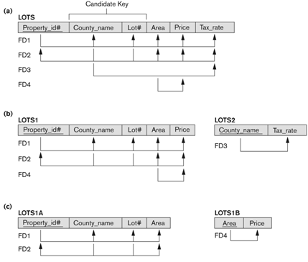

General Definitions of Second and Third Normal Forms
Chapter 10: Functional Dependencies and Normalization for Relational Databases
36

Slide 37
Advantages of Normalization
Greater overall database organization will be gained.
The amount of unnecessary redundant data is reduced.
Data integrity is easily maintained within the database.
The database & application design processes are much more
flexible.
Security is easier to manage.
Chapter 10: Functional Dependencies and Normalization for Relational Databases
43

Slide 38
Disadvantages of Normalization
Produces lots of tables with a relatively small number of columns.
Probably requires joins in order to put the information back together
in the way it needs to be used - effectively reversing the
normalization.
Impacts computer performance (CPU, I/O, memory).
Chapter 10: Functional Dependencies and Normalization for Relational Databases
44

Slide 39
Conclusion
Data normalization is a bottom-up technique that ensures the basic
properties of the relational model:
  No duplicate tuples.
  No nested relations.
A more appropriate approach is to complement conceptual
modeling with data normalization.
Chapter 10: Functional Dependencies and Normalization for Relational Databases
45

Slide 40


